Slide 1



HTML
POINT
World’s First PowerPoint to HTML5 Converter
This slideshow is created with HTML5Point software

Slide 2
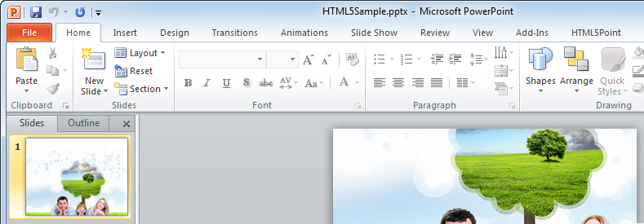
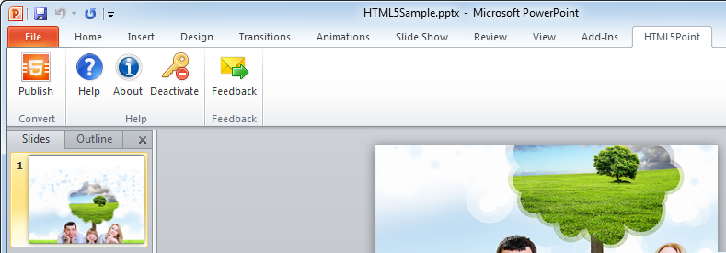
Convert Presentation into HTML5 in simple steps.

Slide 3
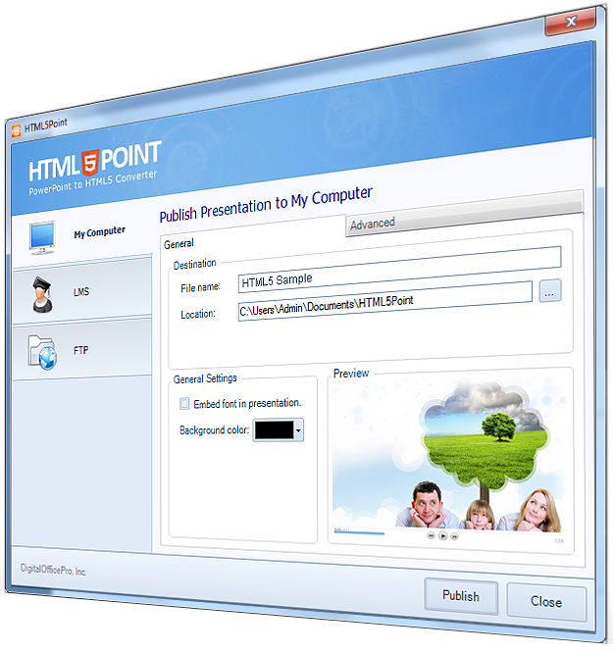
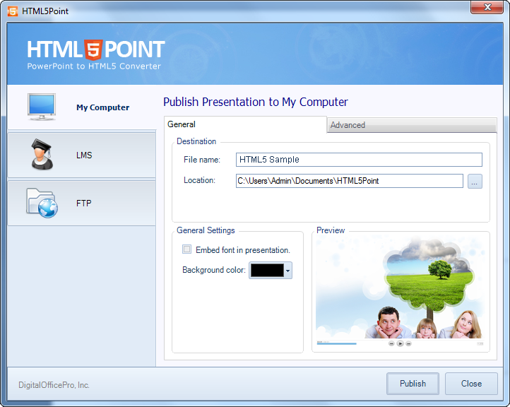
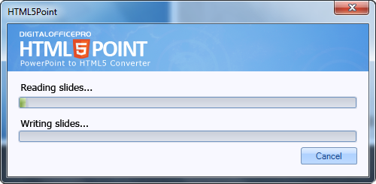
Convert presentation into HTML5 in simple steps.

Slide 4
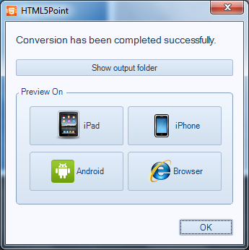
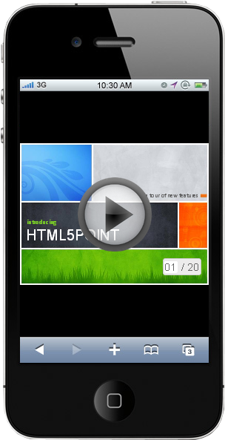
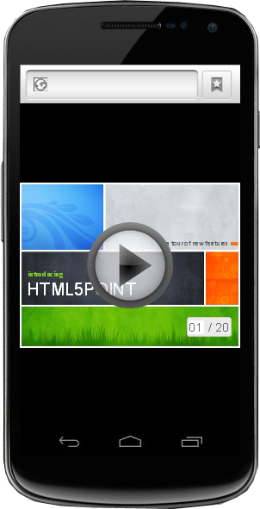
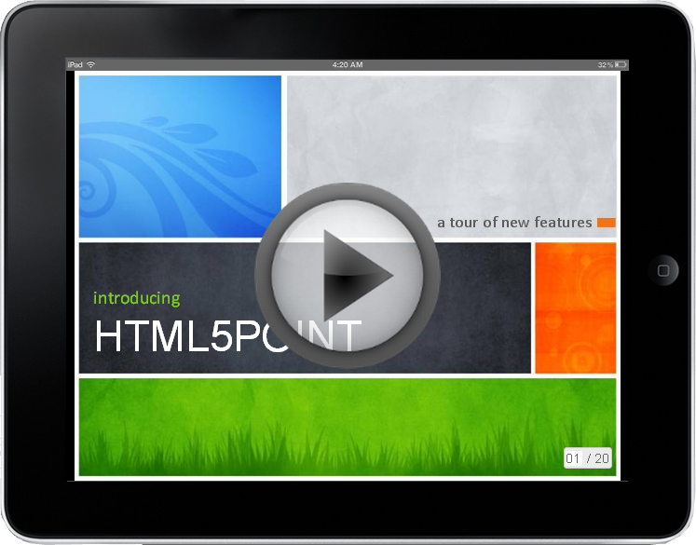
Supports all HTML5 supported devices.
iPad
iPhone
Android Devices

Slide 5
Retains Special Effects Like..
Entrance
Animations And Transitions
Letter By Letter
Word By Word
Emphasis
Multimedia Support
Embedded Videos
Motion
Animated Gifs

Slide 6





And supports all major Internet Browsers

Slide 7





Android
Windows
Apple
Linux
Converted HTML5 output supports

Slide 8
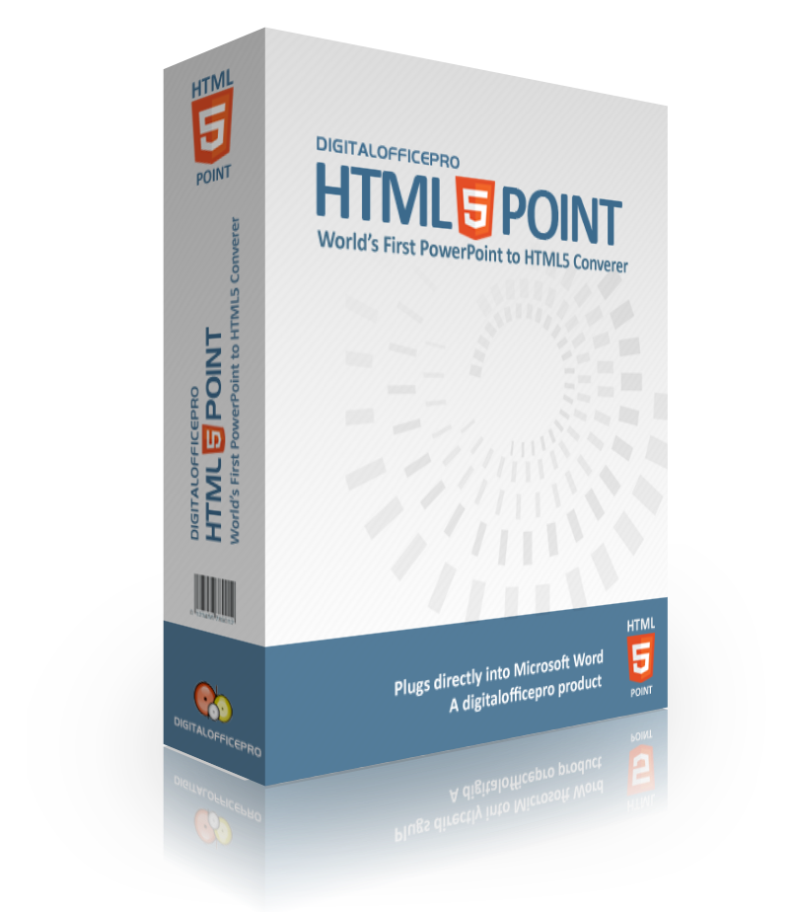
HTML
POINT
Get our free version and discover just how easy it is to use!
Download Now

